Slide 1
MOVIE TICKET BOOKING
-MINI PROJECT
RA2111003011820
RA2111003011840

Slide 2
INTRODUCTION: This project provide the customers facility to movies tickets booking and also view all the movies playing in cinema hall ,through which they can book ticket anytime, anywhere .Movie ticket booking system is basically made for Providing the customer at anytime and anywhere service for booking the seat in the cinema hall and information about the movies . The user can be easily able to know about the movies released and then make the choice .In this project, we will illustrate our system by providing C language .This project uses the concept of File Handling. Admin can check all the transaction It allows users to access their booking history . It allows booking of the ticket at any time without having any maintenance slots.

Slide 3
PROBLEM STATEMENT: To create a platform for public to book tickets for movie of any application and by using internet Objectives: i. To provide another way for the customer to buy cinema ticket, get the information about movies. ii. To provide the customer the complete information of the movie, according to which the customer can view all the movies, book the tickets and the view all transactions facility provides more flexibility to the system.

Slide 4
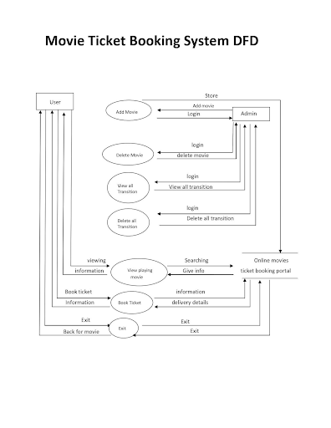

Slide 5
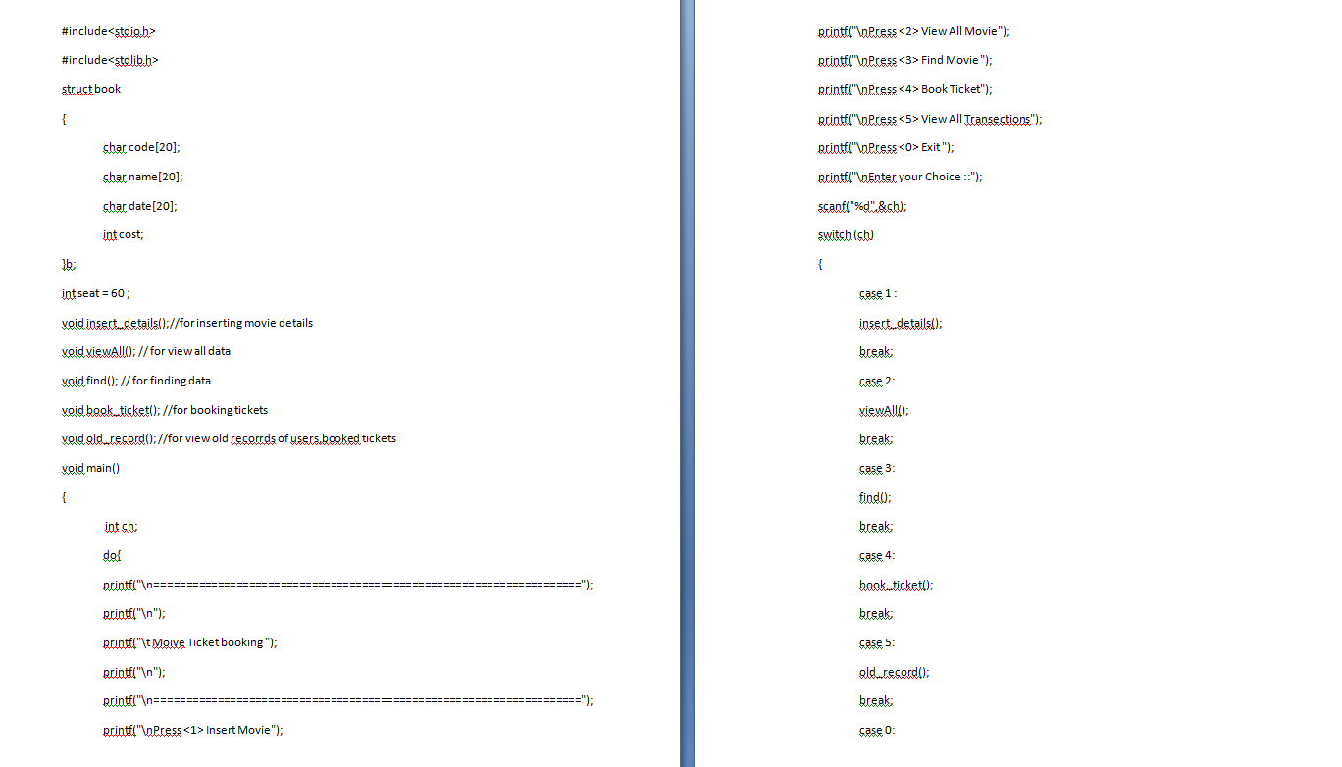

Slide 6
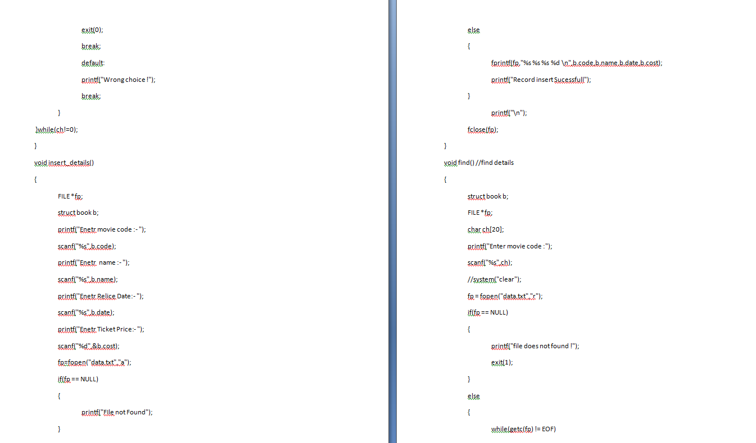

Slide 7
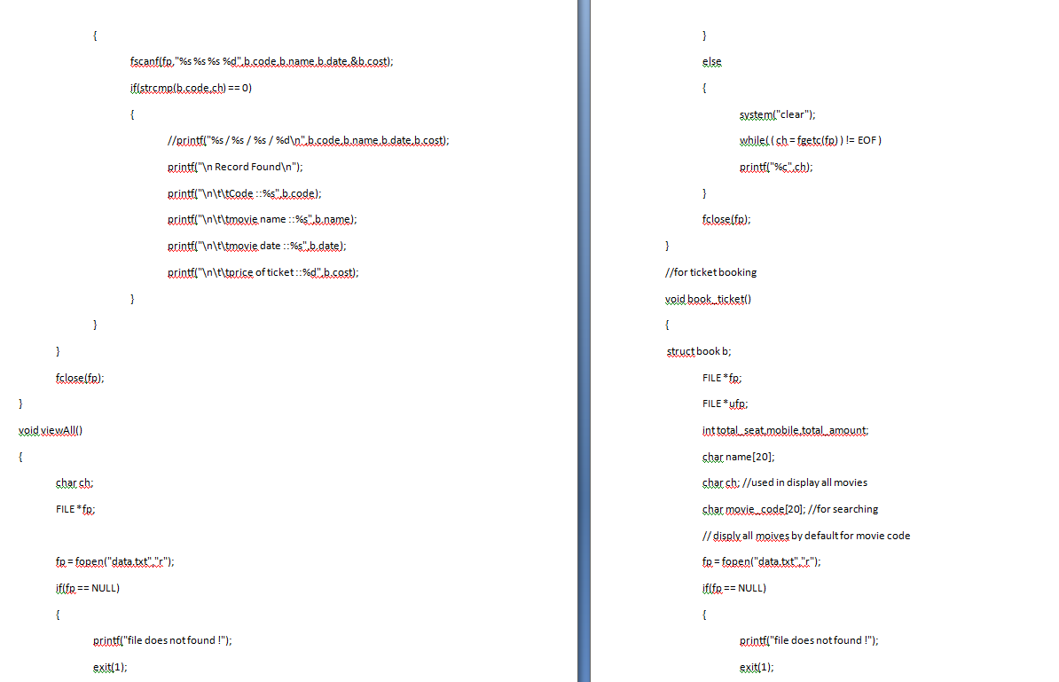

Slide 8
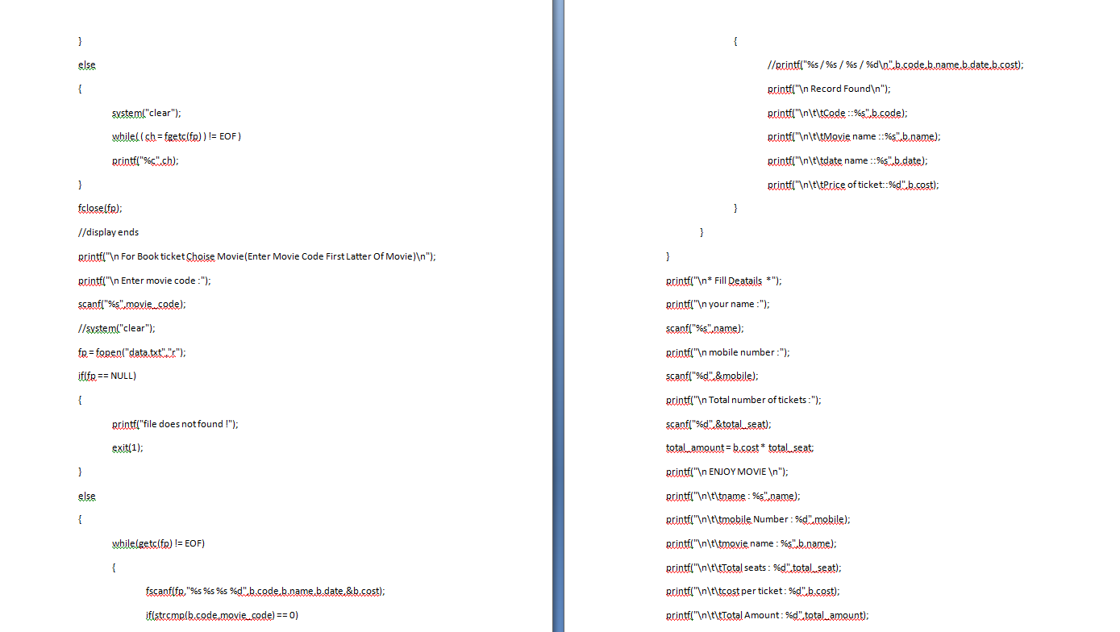

Slide 9
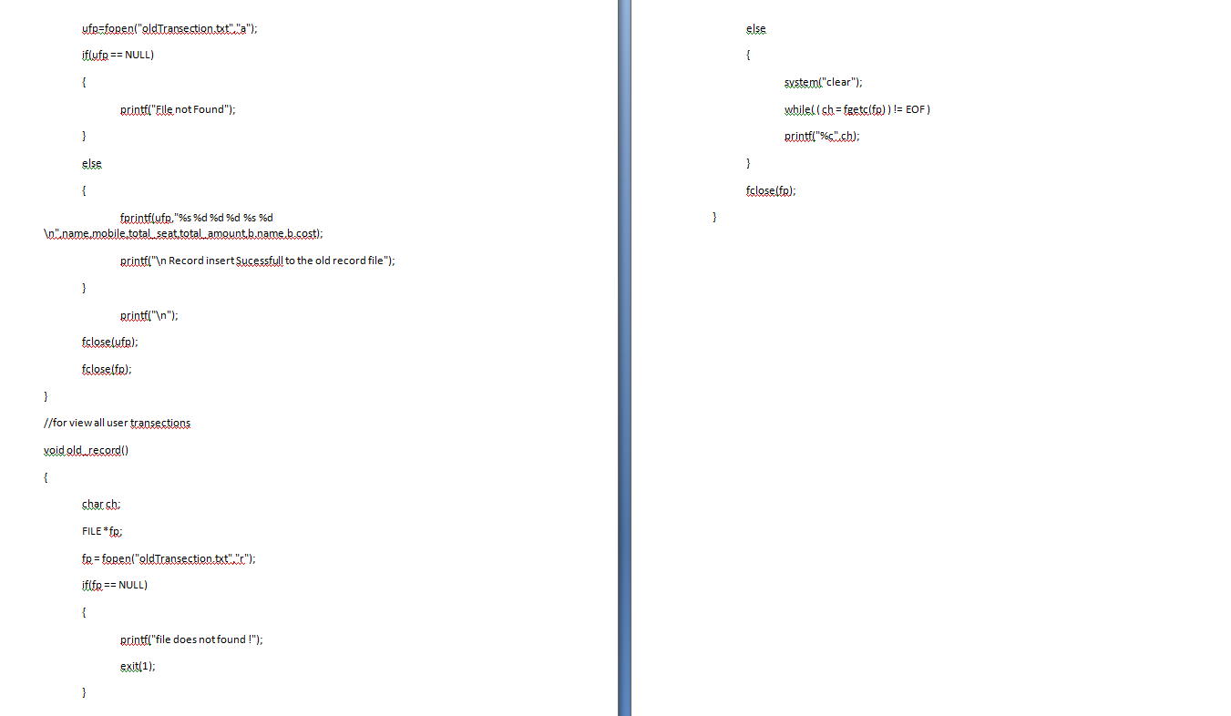

Slide 10
